Slide 1

Tune Box Linux Anda, bukan hanya PostgreSQL

Slide 2

Tune your Linux Box, not just PostgreSQL
Linux Kernel Tuning for PostgreSQL performance
Ibrar Ahmed
Senior Database Architect - Percona LLC
September 08 – 12, 2019

Slide 3







Database Performance
Choose better Hardware
Operating System Selection and Tuning
Choose Database Depend based on Workload
Tune your Database.
Tune your Queries
Tune your Application
SELECT * FROM foo

Slide 4
PostgreSQL Modules
Clients
PostgreSQL Memory
work_mem
Client - psql
Client - JDBC
Client - ODBC
Shared Buffers
Default = 128MB
Processes
Postmaster
Port = 5432
Postgres
Postgres
WAL Buffers
Default = 16MB
maintancework_mem
WAL Writer
Archiver
Checkpointer
Background Writer
Logger
Kernel Memory
Disk Management
4K
2MB/1GB Huge Pages
THP
$PGDATA
Table Spaces
base/ Datafiles
global
pg_wal/ WAL files
Configuration Files
/dev/sda
/dev/sdb

Slide 5
PostgreSQL Performance Tuning

Slide 6
PostgreSQL Tuning
PostgreSQL Memory
work_mem
shared_buffers
wal_buffers
effective_cache_size
work_mem
maintenance_work_mem
synchronous_commit
checkpoint_timeout
checkpoint_completion_target
Shared Buffers
Default = 128MB
WAL Buffers
Default = 16MB
maintancework_mem
Disk Management
$PGDATA
Table Spaces
base/ Datafiles
global
pg_wal/ WAL files
Configuration Files
/dev/sda
/dev/sdb

Slide 7

shared_buffer
PostgreSQL uses its own buffer and also uses kernel buffered I/O.
PostgreSQL does not change the information on disk directly then how?
Writes the data to shared buffer cache.
The backend process write that these blocks kernel buffer.
postgresql=# SHOW shared_buffers;
shared_buffers
----------------
128MB
(1 row)
How/When data written to disk actually?
The proper size for the POSTGRESQL shared buffer cache is the largest useful size that does not adversely affect other activity.
—Bruce Momjian

Slide 8
PostgreSQL Tuning / shared_buffer

Slide 9

Configuraing WAL
Do you have Transaction? Obviously
WAL – (Write Ahead LOG) Log your transactions
Size of WAL files 16MB with 8K Block size (can be changed at compile time)
PostgreSQL writes WAL into the buffers(wal_buffer ) and then these buffers are flushed to disk.
Tip: Bigger value for wal_buffer in case of lot of concurrent connection gives better performance.

Slide 10
effective_cache_size
This used by the optimizer to estimate the size of the kernel's disk buffer cache.
The effective_cache_size provides an estimate of the memory available for disk caching.
It is just a guideline, not the exact allocated memory or cache size.
TIP: It should be large enough to hold most accessed tables, but at the same time small enough to avoid swap.

Slide 11
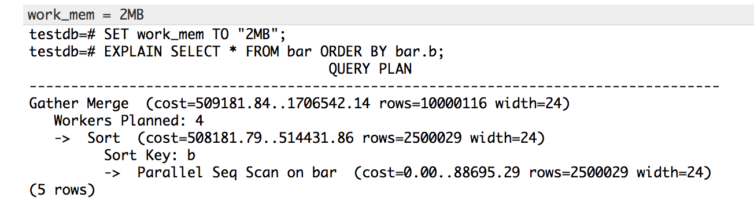
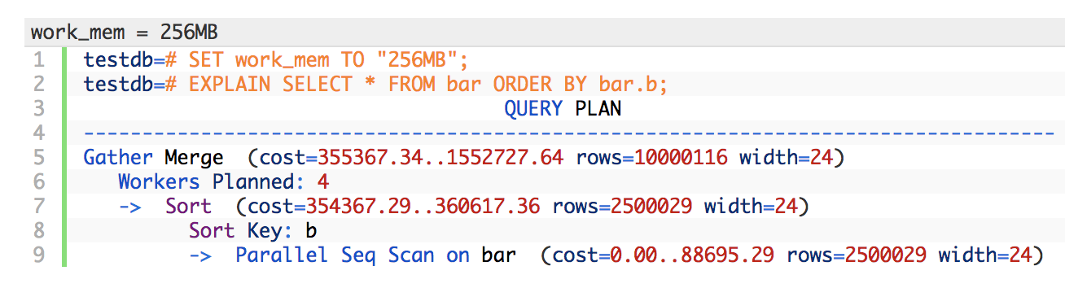
work_mem
This configuration is used for complex sorting.

Slide 12
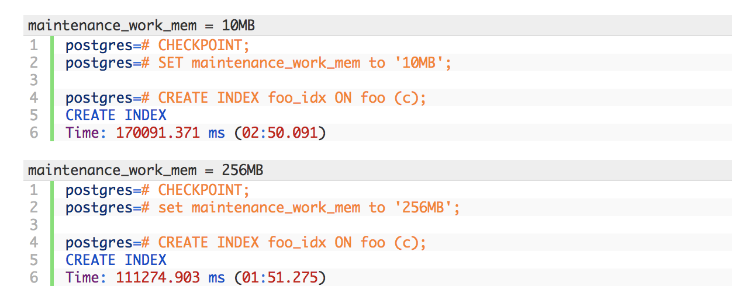
maintenance_work_mem
maintenance_work_mem is a memory setting used for maintenance tasks.
The default value is 64MB.
Setting a large value helps in tasks like VACUUM, RESTORE, CREATE INDEX, ADD FOREIGN KEY and ALTER TABLE.

Slide 13
synchronous_commit
This is used to enforce that commit will wait for WAL to be written on disk before returning a success status to the client.
This is a trade-off between performance and reliability.
Increasing reliability decreases performance and vice versa.

Slide 14
checkpoint_timeout
PostgreSQL writes changes into WAL. The checkpoint process flushes the data into the data files.
More checkpoints have a negative impact on performance.

Slide 15

Linux Kernel Tuning

Slide 16
Input Output Handling
Direct IO, Buffered IO and Double buffering
PostgreSQL believes that the Operating system (Kernel) knows much better about storage and IO scheduling.
PostgreSQL has its own buffering; and also needs the pages cache. Double Buffering
It Increase the use of memory.
And different kernel and setting behave differently.

Slide 17
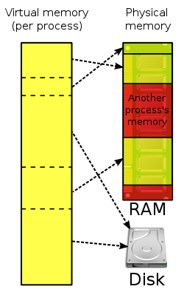
Virtual Memory
Every process is given the impression that it is working with large, contiguous sections of memory
Each process runs in its own dedicated address space
Pages Table are used to translate the virtual addresses seen by the application into Physical Address
https://en.wikipedia.org/wiki/Virtual_memory
https://en.wikipedia.org/wiki/Page_table

Slide 18
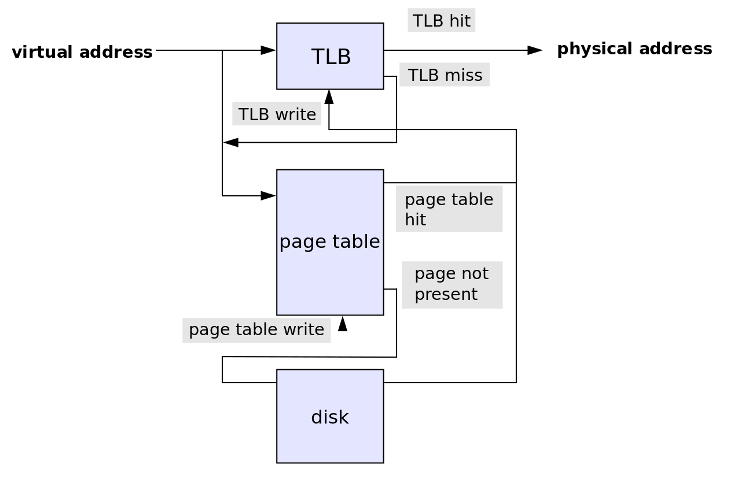

Translation Lookaside Buffer (TLB)
Translation Lookaside Buffer is a memory cache
It reduce the time to access a user memory location
If a match is found the physical address of the
page is returned → TLB hit
If match not found scan the page table (walk)
looking for the address mapping (entry) → TLB miss
Small page size bigger TLB size → expensive

Slide 19
Memory Pages
Different OS has different size of Pages
Linux has a concept of Classic Huge Pages and Transparent Huge Pages.
BSD has Super Pages.
Windows has Large Pages.

Slide 20
Linux Page sizes
Linux Page size is 4K
Many modern processors support other page sizes
If we consider a server with 256G of RAM:
4K | 67108864
2M | 131072
1G | 256
large/huge pages
Notes:
The address translation logic is also known as page table walking
The page table walk is expensive because it may require multiple memory accesses
Using large pages to improve the effectiveness of the TLB
by increasing the page size we'll have less pages to map

Slide 21
Classic Huge Pages 1/3
# cat /proc/meminfo
MemTotal: 264041660 kB
...
Hugepagesize: 2048 kB
DirectMap4k: 128116 kB
DirectMap2M: 3956736 kB
DirectMap1G: 266338304 kB
sysctl -w vm.nr_hugepages=256
Notes:
"Default" huge page size
DirectMap here is related to TLB use, I'm unsure if accurate though

Slide 22
Classic Huge Pages 2/3 – Setting Huge Page Size
# vi /etc/default/grub
GRUB_CMDLINE_LINUX_DEFAULT="hugepagesz=1GB default_hugepagesz=1G”
# update-grub
Generating grub configuration file ...
Found linux image: /boot/vmlinuz-4.4.0-75-generic
Found initrd image: /boot/initrd.img-4.4.0-75-generic
Found memtest86+ image: /memtest86+.elf
Found memtest86+ image: /memtest86+.bin
Done
# shutdown -r now
Notes:
huge page size can only be changed at boot time

Slide 23
Classic Huge Pages 3/3 – Enabling / Disabling in PostgreSQL
# vim /etc/postgresql/10/main/postgresql.conf
huge_pages=ON # default is try
# service postgresql restart

Slide 24
Transparent Huge pages
The kernel works in the background (khugepaged) trying to:
"create" huge pages.
Find enough contiguous blocks of memory
Convert them into a huge page
Transparently allocate them to processes when there is a "fit"
Notes:
Transparent Hugepage Support is an alternative means of using huge pages for the backing of virtual memory with huge pages that supports the automatic promotion and demotion of page sizes

Slide 25
Disabling Transparent Huge pages
# cat /proc/meminfo | grep AnonHuge
AnonHugePages: 2048 kB
# ps aux | grep huge
root 42 0.0 0.0 0 0 ? SN Jan17 0:00 [khugepaged]
To disable it:
at runtime:
# echo never > /sys/kernel/mm/transparent_hugepage/enabled
# echo never > /sys/kernel/mm/transparent_hugepage/defrag
at boot time:
GRUB_CMDLINE_LINUX_DEFAULT="(...) transparent_hugepage=never"

Slide 26
vm.swappiness
This is another kernel parameter that can affect the performance of the database.
Used to control the swappiness (swapping pages to swap memory into RAM) behavior on a Linux system.
This parameter's can take anything from “0” to “100”, default is 60.
Higher value means more aggressively swap.

Slide 27
vm.overcommit_memory and vm.overcommit_ratio
Applications acquire memory and free that memory when it is no longer needed.
But in some cases an application acquires too much memory and does not release it. This can invoke the OOM killer.
Heuristic overcommit, Do it intelligently (default); based kernel heuristics
Allow overcommit anyway
Don’t over commit beyond the overcommit ratio.

Slide 28
vm.dirty_background_ratio and vm.dirty_background_bytes
The vm.dirty_background_ratio is the percentage of memory filled with dirty pages that need to be flushed to disk.
Flushing is done in the background.
The value of this parameter ranges from 0 to 100;

Slide 29
vm.dirty_ratio / vm.dirty_bytes
The vm.dirty_background_ratio is the percentage of memory filled with dirty pages that need to be flushed to disk.
Flushing is done in the foreground.
The value of this parameter ranges from 0 to 100;

Slide 30
Blogs
Tuning PostgreSQL Database Parameters to Optimise Performance.
https://www.percona.com/blog/2018/08/31/tuning-postgresql-database-parameters-to-optimize-performance/
Tune Linux Kernel Parameters For PostgreSQL Optimisation
https://www.percona.com/blog/2018/08/29/tune-linux-kernel-parameters-for-postgresql-optimization/

Slide 31

?
“Poor leaders rarely ask questions of themselves or others. Good leaders, on the other hand, ask many questions. Great leaders ask the great questions.”
Michael Marquardt author of Leading with Questions

